Slide 1
Unmanned Aerial Aehicle (UAV)
ABDULALEM ALI ABDULLAH ALMAEESH
1714949

Slide 2
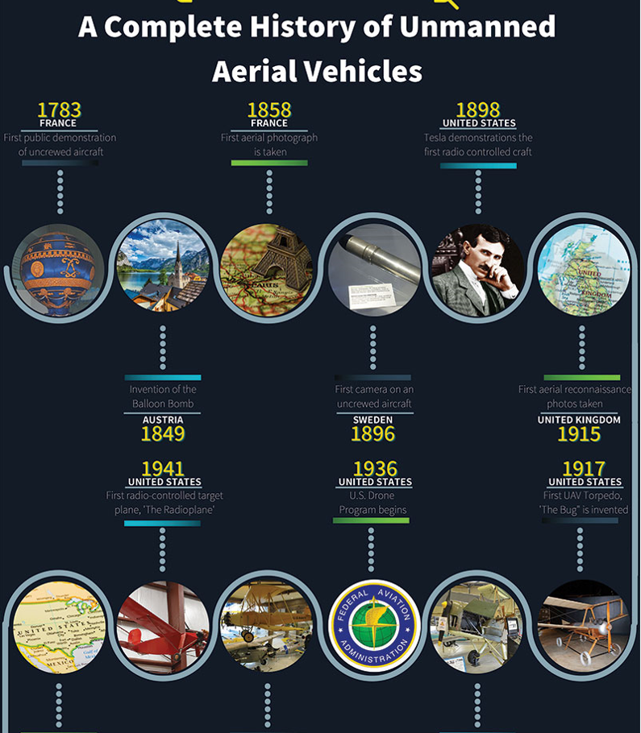
HISTORY OF THE UAVs

Slide 3
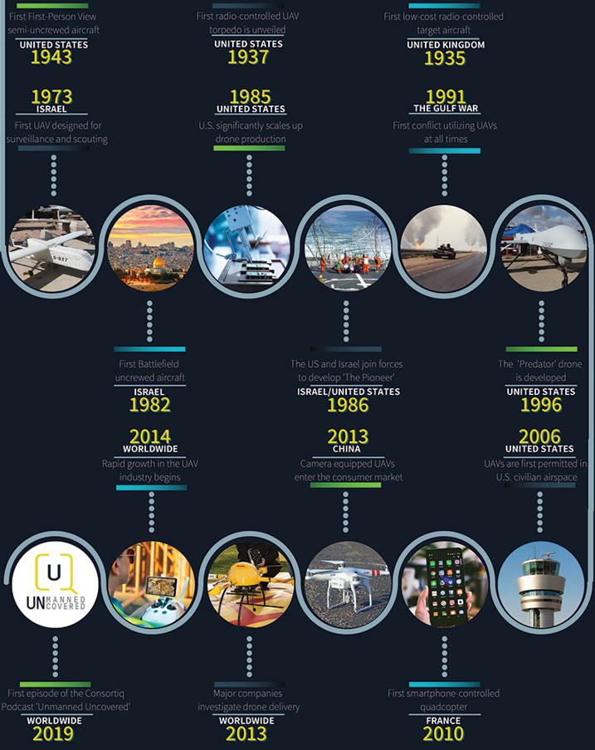
HISTORY OF THE UAVs

Slide 4
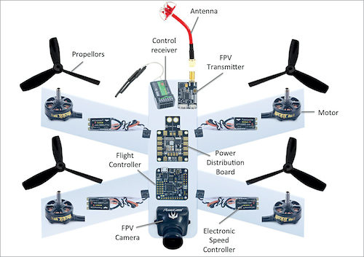
Drone Architecture
Basic components:
Motor: are the powerhouses that give the drone the thrust to reach the insane speeds
Propellers: A drone uses two clockwise(cw) and two for counterclockwise(ccw) for balance.
Antenna: usually two antennas are used one to send out the video and another to received it.
Flight Controller: is the brain of drone taking into account the angle of the drone the control input calculates how fast the motors should spins and send the signals into the ESCs

Slide 5
Drone Architecture
Basic components: Contd
Transmitter: remote control is an electronic device with produces radio waves with an antenna and allows to control the craft.
FPV camera: This is the eye of the drone anything it can see we can see in the mobile phone or goggles.
PDB: power distribution board takes the voltage of the battery and distribute it on the electronics

Slide 6
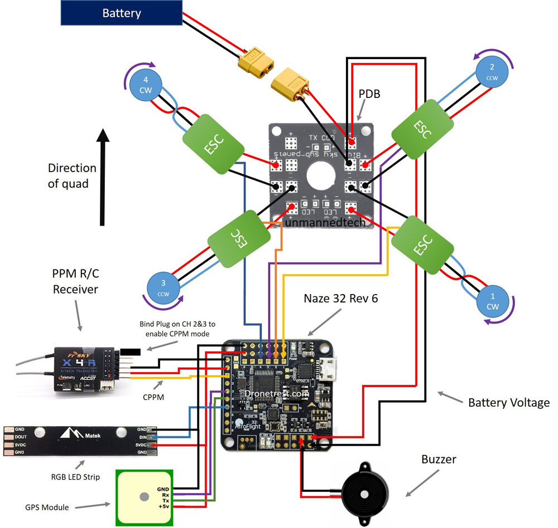
System wiring diagram

Slide 7
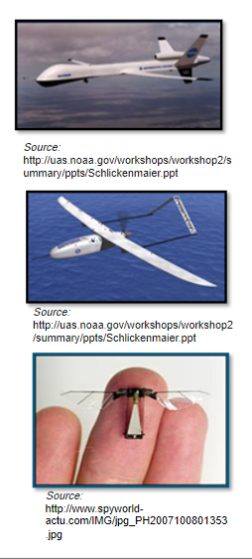
Drones Design and Task
Types
Fixed wing
Quad rotors and octo-copters
Micro air vehicles (MAVs)
Navigation
- Remote Control ground station
- Automation Systems
- Satellite data link

Slide 8
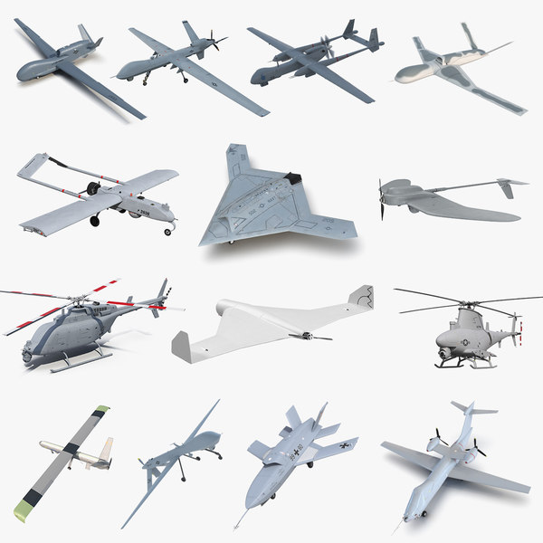
Potential Uses
Military
- Intelligence Gathering
- Combat missions
Law enforcement And Security Surveillance
- Crime investigation
- Border protection
- Security of commercial properties
- others

Slide 9
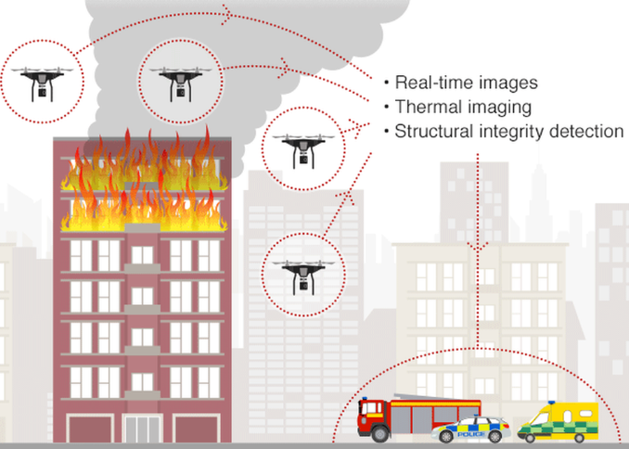
Potential Uses
Search and Rescue operations
- Search and rescue
- Delivery of supplies and food to disaster areas
Agriculture
- Monitor crops
- Crop spraying
- Locate Livestock and assess
- others

Slide 10
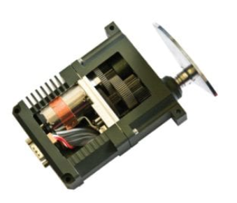
Actuators and Locomotion
Actuators: Actuators are components that convert energy into mechanical motion in order to move or control a mechanism or system. They rely on an energy source such as electrical current, hydraulic pressure or pneumatic pressure, and are activated by a control signal such as voltage, current, pressure or human exertion. Actuators can be found in many subsystems of unmanned aerial vehicles (UAVs) and other robotic vehicles.

Slide 11
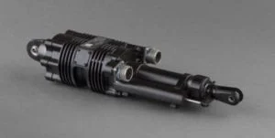
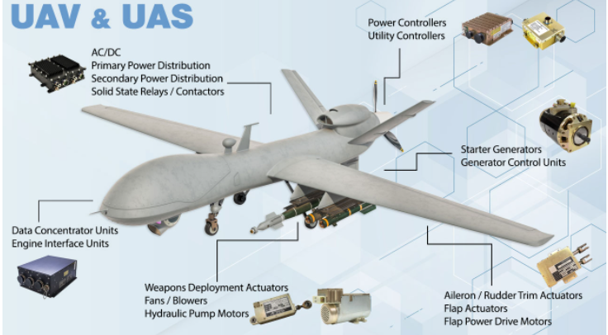
Actuators and Locomotion
Actuator Types
Electric Actuators
Servo Actuators
Pneumatic Actuators
Hydraulic Actuators
Flight Control Actuation Systems
Actuators are also commonly used to move flight and attitude control surfaces on UAVs, such as the elevator, ailerons, flaps and nose wheel. Other unmanned aircraft applications include opening and closing the throttle valve on combustion engines, as well as doors and hatches.

Slide 12
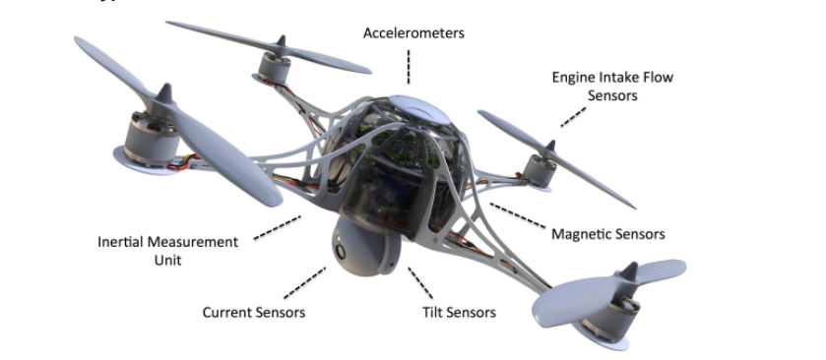
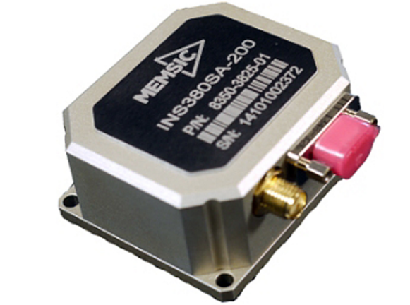
Navigation System & Controller
Accelerometers: are used to determine position and orientation of the drone in flight
Inertial Measurement Units: combined with GPS are critical for maintaining direction and flight paths. As drones become more autonomous, these are essential to maintain adherence to flight rules and air traffic control.

Slide 13
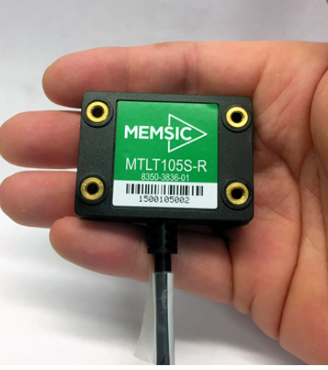
Navigation System & Controller
Tilt Sensors: Tilt sensors, combined with gyros and accelerometers, provide input to the flight-control system in order to maintain level flight. This is extremely important for applications where stability is paramount, from surveillance to delivery of fragile goods.

Slide 14
Navigation System & Controller
Current Sensors: Current sensors can be used to monitor and optimize power drain, safe charging of internal batteries, and detect fault conditions with motors or other areas of the system.
Magnetic Sensors: In drones, electronic compasses provide critical directional information to inertial navigation and guidance systems. Anisotropic magnetoresistive (AMR) permalloy technology sensors, which have superior accuracy and response time characteristics while consuming significantly less power than alternative technologies, are well-suited to drone applications.
Engine Intake Flow Sensors: Flow sensors can be used to effectively monitor air flow into small gas engines used to power some drone varieties. These help the engine CPU determine the proper fuel-to-air ratio at a specified engine speed, which results in improved power and efficiency, and reduced emissions.

Slide 15
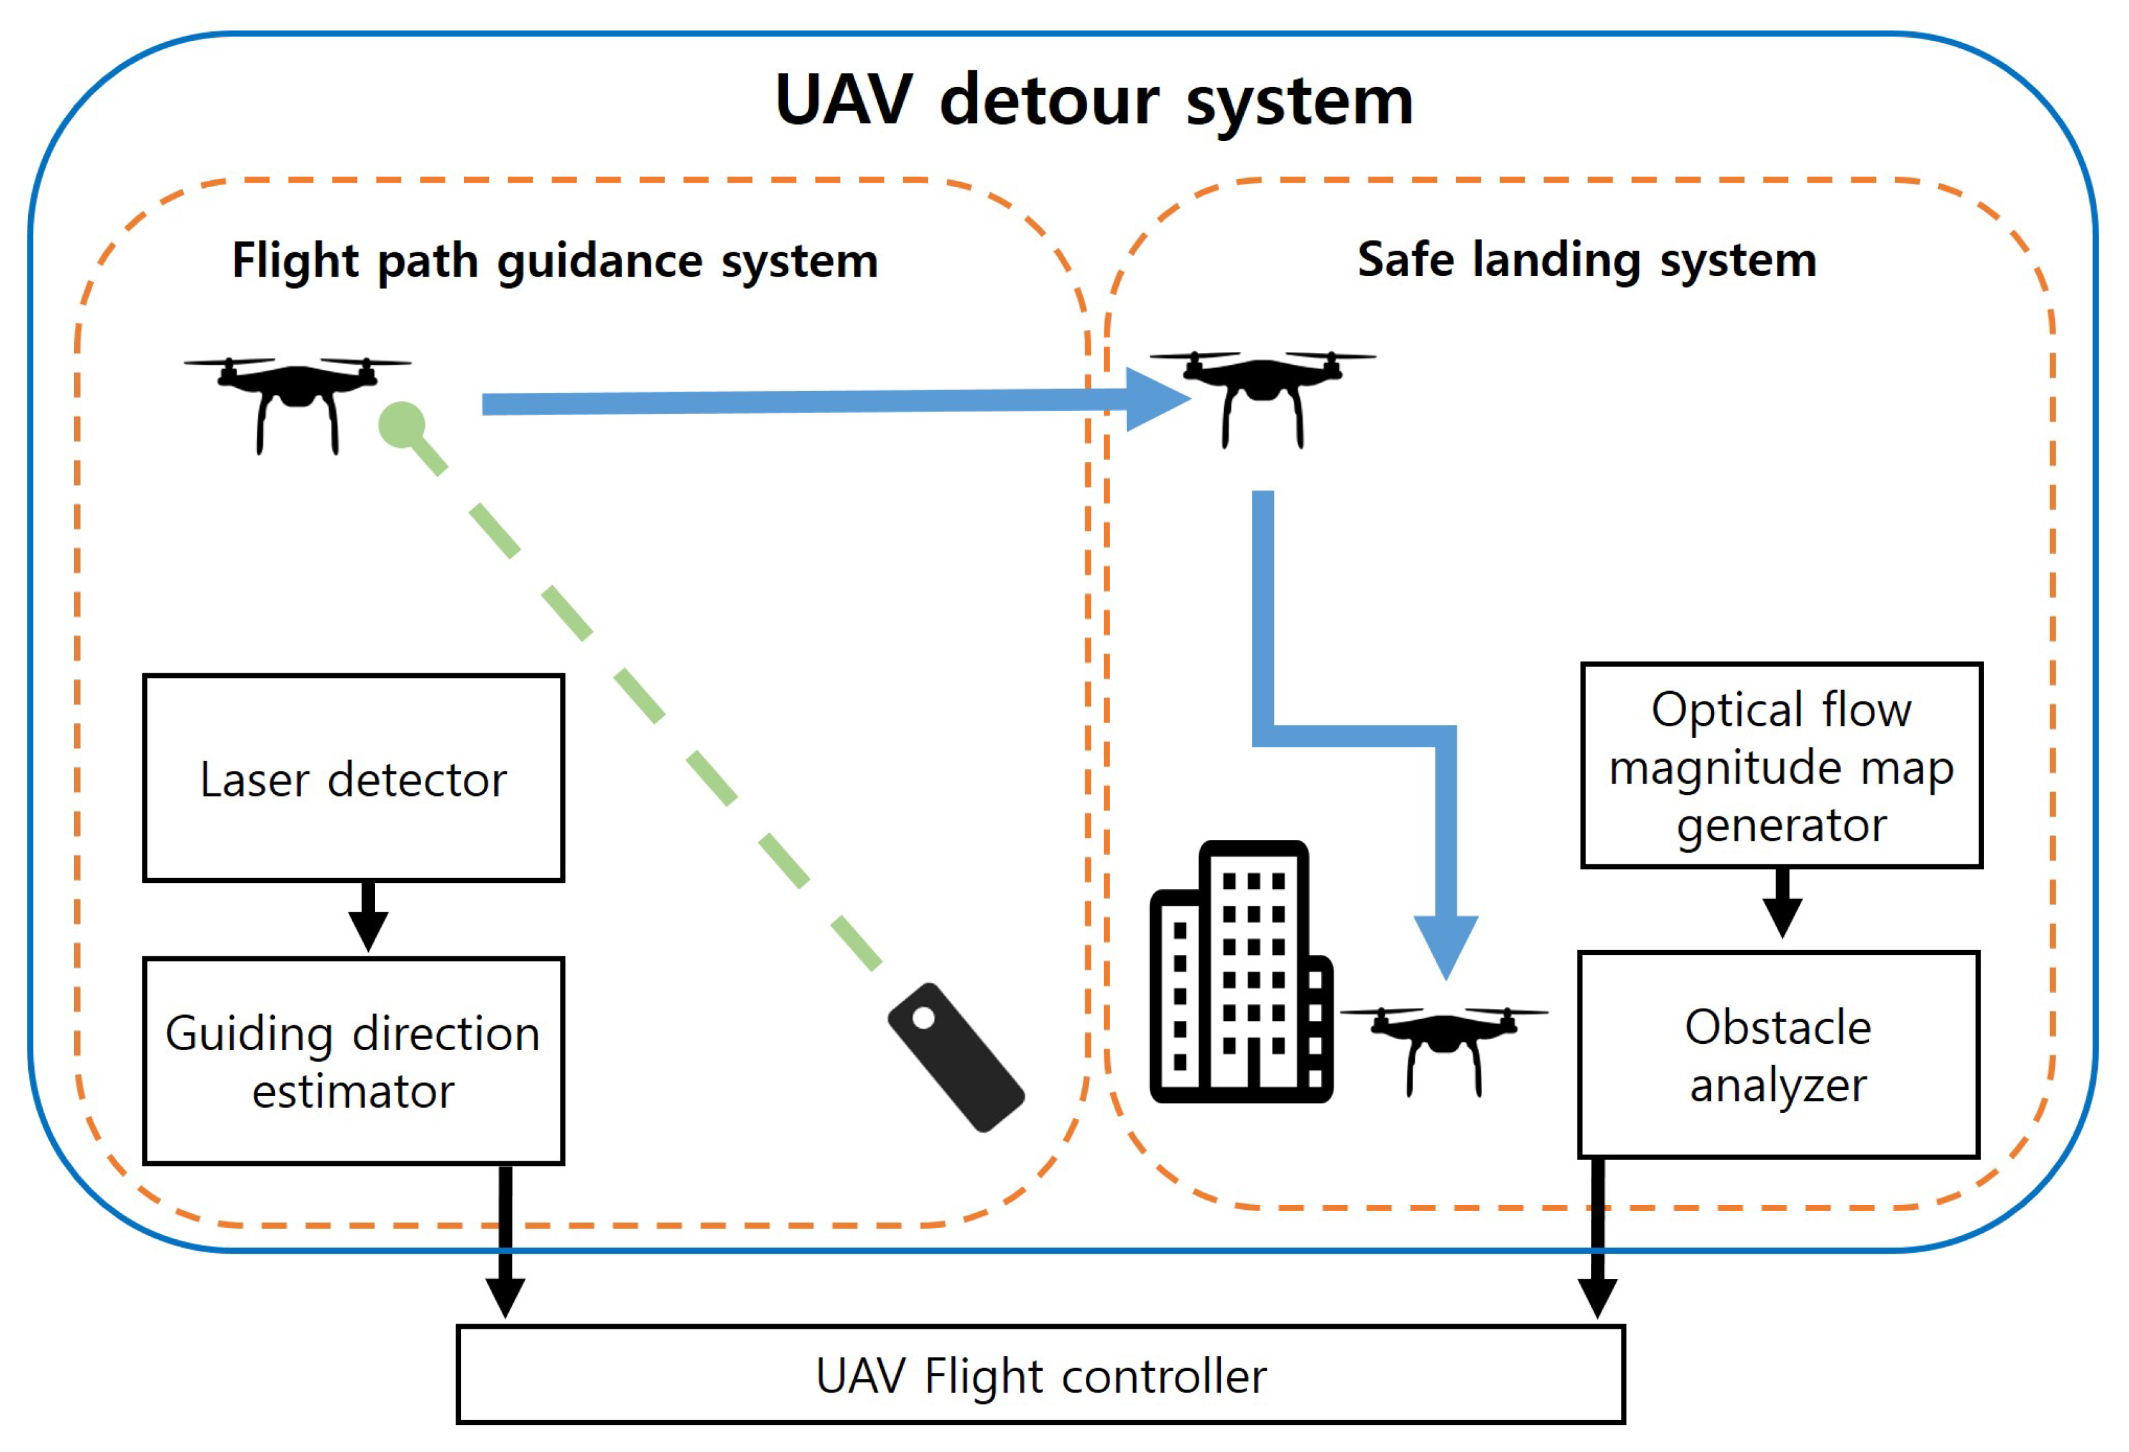
UAV Flight Controller

Slide 16
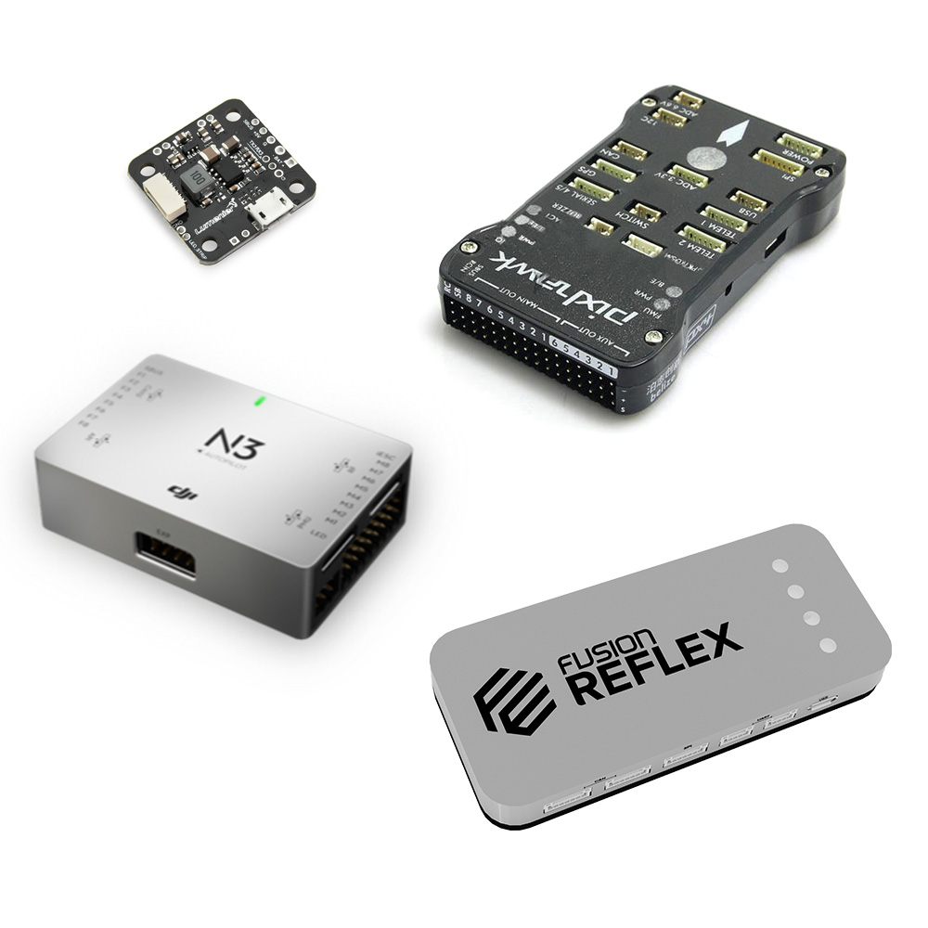
UAV Flight Controller
What is a flight controller?
Physically, a flight controller is nothing more than a circuit board with electronic chips on them. You can compare them to the motherboard and processor in your laptop. The flight controller is the brain of a drone. A small box filled with intelligent electronics and software, which monitors and controls everything the drone does. And just like the brains of different organisms, flight controllers also vary in sizes and complexity. (picture of different flight controllers)
What does a flight controller for drones do?
Perception (sensing)
Controlling
Communicating

